Slide 1

SMART INDIA HACKATHON 2026
Problem Statement ID –26058
Problem Statement Title- Development of a Low-Power, Real-Time Adaptive Software-Defined Sonar Transmitter Payload for Autonomous Underwater Vehicles (AUVs)
Theme-Robotics and Drones
PS Category- Hardware
Team ID- VCE-SIH26-009
Team Name:- Still-thinking

Slide 2
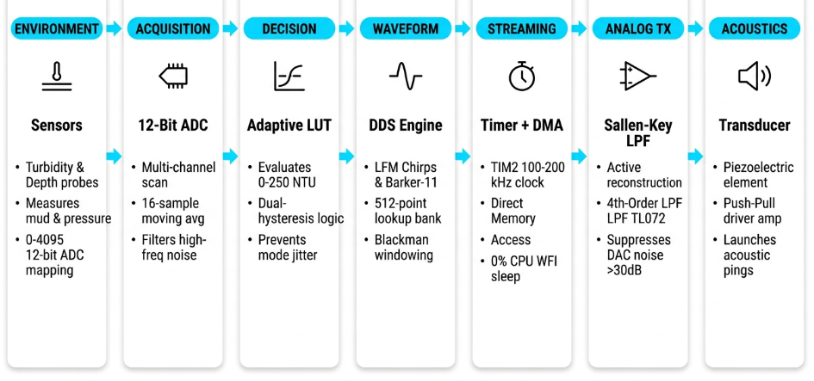
Still-thinking
Proposed Solution​
A Software-Defined Adaptive Sonar Transmitter Payload for AUVs that dynamically changes frequency, pulse duration, and bandwidth in real time based on underwater conditions (turbidity, depth, salinity)—replacing fixed-frequency sonar systems that lose effectiveness in murky or thermally stratified water
APLITUDE / SIGNAL POWER

Slide 3
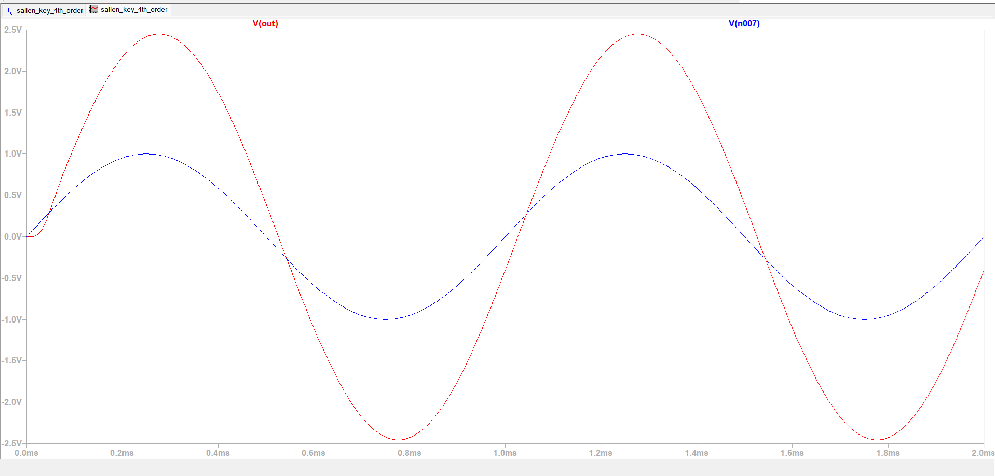

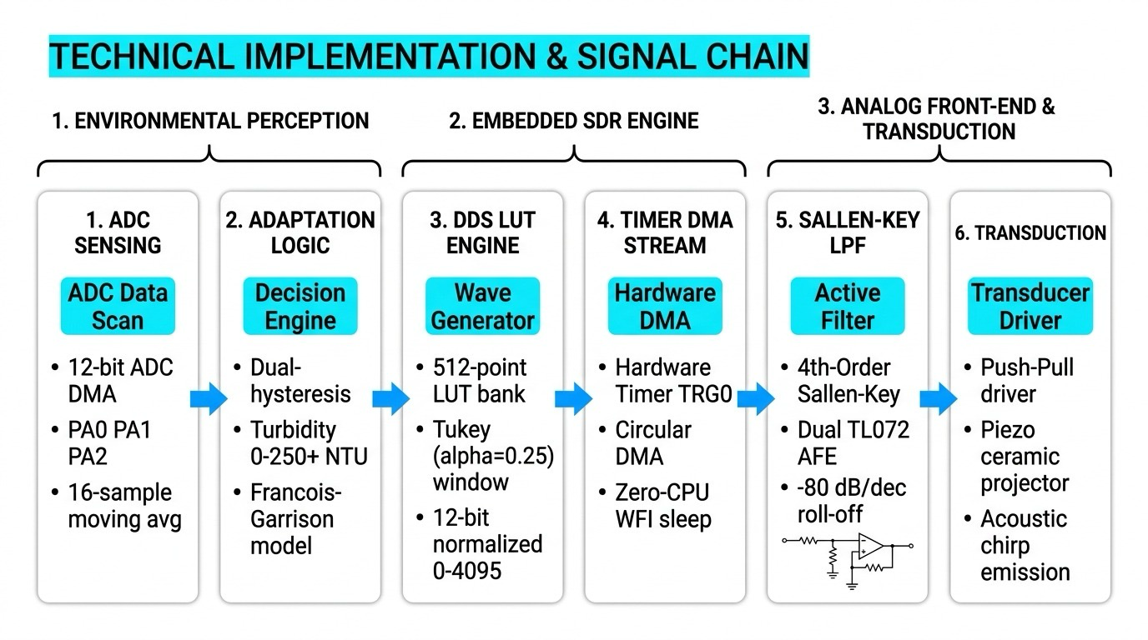
Still-thinking
TECHNICAL APPROACH
The architecture is intentionally split into sensing, embedded DSP, analog conditioning and validation.
Python 3.11 DSP
@SIH Idea submission • Template
3

Slide 4
Still-thinking

Slide 5
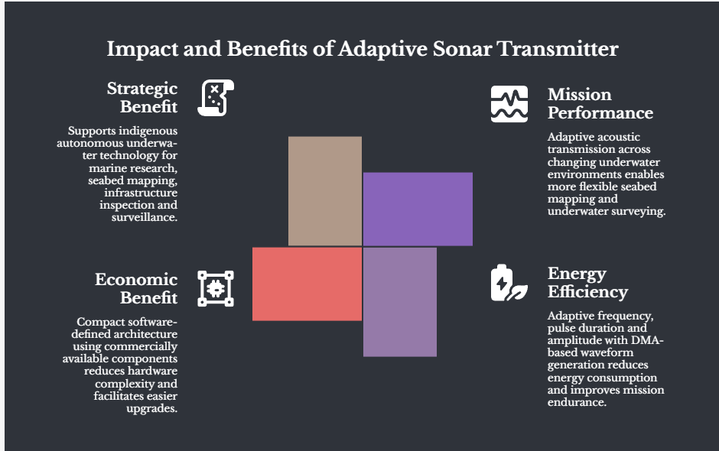
IMPACT AND BENEFITS
Still-thinking
Potential Impact
Adaptive Performance: Reliable operation across clear, turbid and deeper waters.
Longer Mission Endurance: Energy-aware transmission reduces unnecessary acoustic power.
Reduced Payload Complexity: One software-defined payload replaces multiple fixed acoustic profiles.
Greater Reliability: Autonomous adaptation without continuous human intervention.
Target Users
Indian Navy & Coast Guard: Affordable adaptive sonar for small patrol AUVs.
NIOT & NCPOR: Low-cost bathymetric survey AUVs with research-grade resolution.
Offshore Oil & Gas: Pipeline inspection AUVs adapting to turbid, deep-water conditions.
.

Slide 6
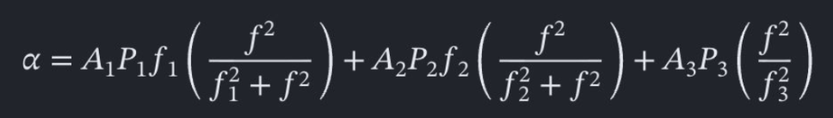
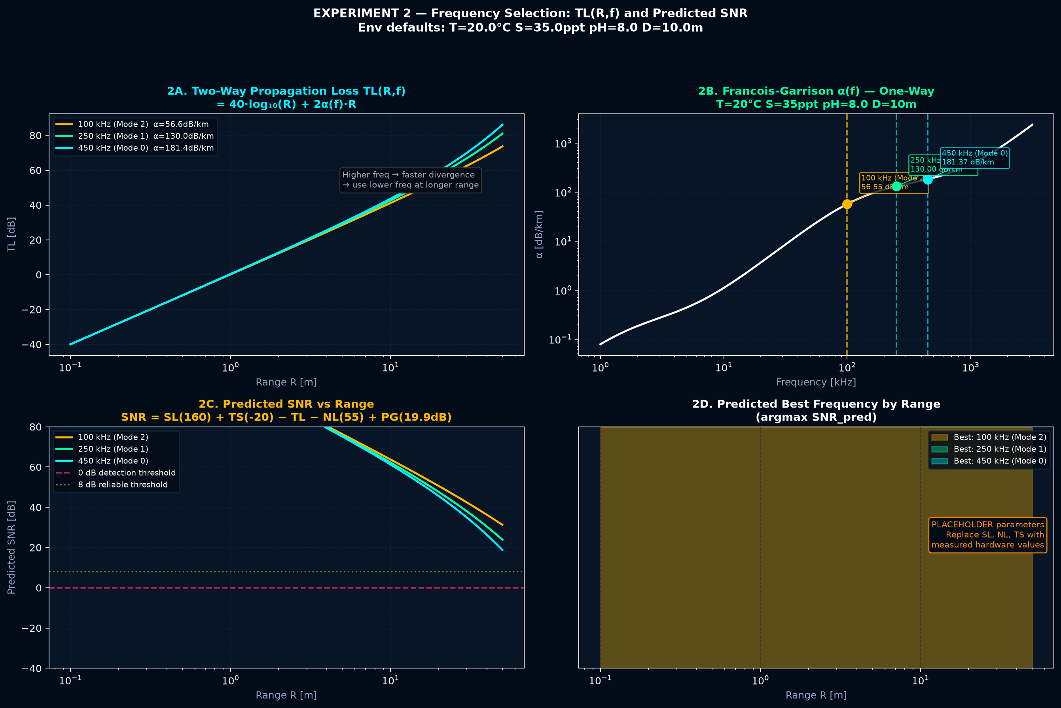
Still-thinking
Scientific basis behind the adaptive chain
Acoustic absorption, LFM pulse compression and active filtering anchor the design.
01
Francois & Garrison (1982)
RESEARCH → DESIGN
Sound absorption based on ocean measurements — JASA.
OCEAN PHYSICS
Basis for seawater absorption modelling.
Link: https://pubs.aip.org/asa/jasa/article-abstract/72/3/896/774694/Sound-absorption-based-on-ocean-measurements-Part
Francois–Garrison
02
Ainslie & McColm (1998)
A simplified formula for viscous and chemical absorption in sea water — JASA.
SIMPLIFIED ABSORPTION
Frequency-dependent absorption modelling.
Link: https://pubs.aip.org/asa/jasa/article-abstract/103/3/1671/557895/A-simplified-formula-for-viscous-and-chemical
Ainslie–McColm
03
LFM / Pulse Compression
LFM / PULSE COMPRESSION
Underwater sonar literature on LFM chirps, SNR and range resolution.
Sonar literature
Waveform + matched-filter design.
Link: https://www.sxjs.ac.cn/en/article/doi/10.3969/j.issn1000-3630.2014.03.018
ACTIVE FILTERING
04
Sallen & Key (1955)
Sallen–Key
A Practical Method of Designing RC Active Filters.
Active reconstruction filter design.
Link: https://ieeexplore.ieee.org/document/6500159
Sources: AIP / JASA • SXJS sonar paper • IEEE Xplore
@SIH Idea submission • Template
6

